Slide 1




EduMatix
A Roadmap for Engineering Students
Embark on a successful engineering journey with our comprehensive year-wise roadmap. Discover core courses, specialization options, and research opportunities. Explore scholarships and unleash the power of e-learning for engineering success.

Slide 2
First Year Roadmap
Introduction to Engineering Curriculum
Core Courses to Take
Scholarships for First-Year Engineering Students
Recommended E-learning Apps and Websites
Discover the essential courses that build the knowledge and skills required for engineering specialization.
Begin your engineering journey by understanding the fundamentals of the curriculum, laying a strong foundation for future success.
Explore scholarships tailored specifically for first-year engineering students, providing financial support from the start.
Enhance your learning experience with our curated list of e-learning apps and websites designed to support first-year engineering studies.

Slide 3
Second Year Roadmap
1
Specialization Courses to Consider
2
Internship and Co-op Opportunities
Delve into exciting fields of study as you choose your engineering specialization, exploring advanced coursework.
Gain real-world experience through internships and co-op programs, bridging the gap between theory and practice.
3
Scholarships for Second-Year Engineering Students
4
Updated List of E-learning Apps and Websites
Discover scholarships for second-year engineering students, providing financial support as you progress in your studies.
Stay ahead of the curve with an updated list of e-learning apps and websites tailored to second-year engineering studies.

Slide 4



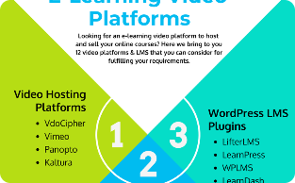
Third Year Roadmap
Advanced Courses for Specialization
Research Opportunities
Scholarships for Third-Year Engineering Students
Additional E-Learning Resources for Advanced Concepts
Engage in cutting-edge research projects, collaborating with experts and contributing to the advancement of engineering knowledge.
Elevate your understanding of your chosen specialization with advanced courses tailored to your field of interest.
Access various scholarships exclusively available to third-year engineering students, supporting your academic and research pursuits.
Bolster your understanding of advanced engineering concepts with a handpicked selection of e-learning resources.

Slide 5
Fourth Year Roadmap
Senior Design Project
Career Development Resources
Immerse yourself in a challenging senior design project that showcases your engineering skills and demonstrates your ability to solve complex problems.
Access invaluable resources and guidance to shape your career path, including resume-building tips, interview preparation, and networking opportunities.
Graduation Requirements
Scholarships for Fourth-Year Engineering Students
Stay informed about the requirements and milestones to ensure a smooth transition from student to graduate.
Explore scholarships specifically available to fourth-year engineering students, providing support in your final academic year.

Slide 6
Scholarship Opportunities
Overview of Different Scholarships
Criteria and Application Process
Tips for Writing a Strong Application
Discover a wide range of scholarships available to engineering students, providing opportunities for academic excellence and financial assistance.
Understand the criteria and application process for each scholarship, ensuring you are well-prepared to submit a strong application.
Unleash the power of your scholarship application with expert tips and strategies to impress scholarship committees.

Slide 7
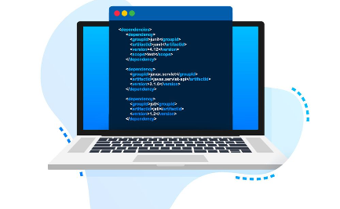

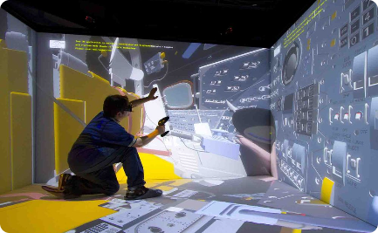
Useful E-Learning Apps and Websites
Interactive Coding Platforms
Online Engineering Libraries
Virtual Simulation Tools
Explore interactive coding platforms that make learning programming languages engaging and hands-on.
Access vast collections of online engineering libraries, offering a wealth of resources such as textbooks, research papers, and technical documentation.
Experience realistic engineering simulations through virtual tools that allow you to practice concepts and solve complex problems.

Slide 8

Ready to Start Your Engineering Journey?
Unlock endless possibilities by following our comprehensive roadmap, accessing scholarships, and harnessing the power of e-learning. Begin your path to engineering success now!

